Slide 1
FY 24 Budget Solutions
(Phase II – Recommendations and Ongoing Research)
October 18th, 2022

Slide 2
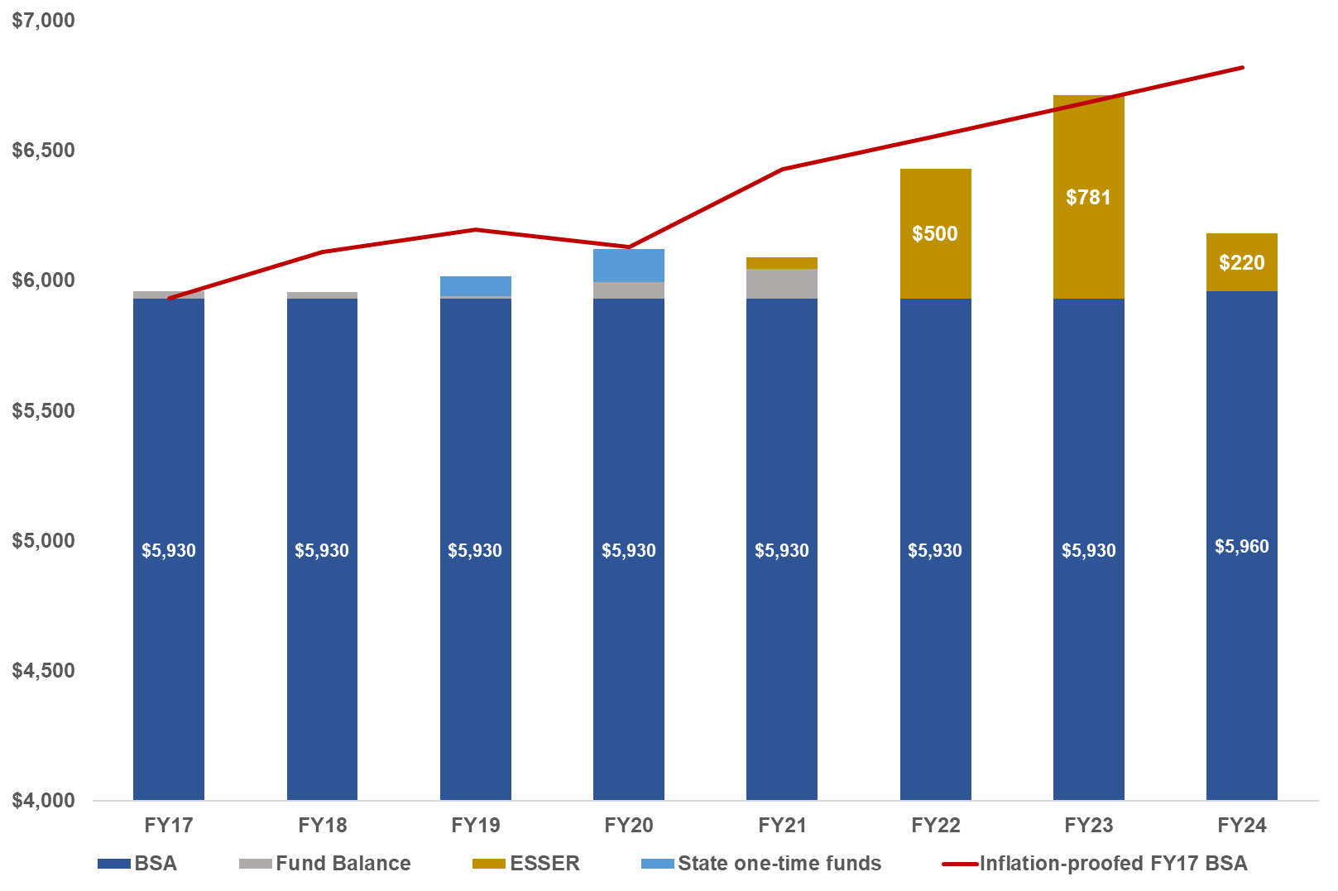
ASD School Funding since 2017
Inflation-proofed BSA
in FY24 = $6,820
$640
ASD revenue is depicted in BSA-equivalent dollars
Created by ASD Finance, JEA, Oct 18th, 2022
2

Slide 3







FY 24 Budget - Areas ID’d for Detailed Analysis
Review schools for closure/repurpose, school-based minimum and metric-based staffing levels, ASDV, special programs (e.g. immersion & IB), MS model, pull-out programs (IGNITE, 6th grade band/orchestra, etc.) and other changes within the schools or programs that improve instructional capacity or reduce costs.
Review ESSER II/III planned expenditures to help soften FY 24 deficit
Review 1:1 costs & short/long-term plan to support elementary and secondary, district software (sunset committee), policy & procedure for lost/broken student equipment
Review District Administrative staff, contracts, insurance coverage limits, Student Nutrition debt practices, facility rental fees, Student Transportation, etc.
Potential for increased revenue (i.e., outsource capabilities to other districts/municipalities, expand Medicaid reimbursement, etc.)
Review sports and activities to determine potential cost savings and possible reduce/outsource programs. Review activity fee rates and gate fees for games
ASD’s prioritization efforts will be informed through layered community, family and staff input (surveys, town halls, etc.)
3

Slide 4
FY24 Budget Deficit Monitor
School Board future discussions
FY 24 Deficit
(in $Millions)
Defer planned FY 23 ESSER spending
Sunset Committee analysis
Review alternative schedules (trimesters, lecture hall, start times, etc.)
1:1 computer plan options @ ES & MS levels
100
90
80
70
Preserve ≈ $16M one-time state funds for FY24
Meet or exceed FY23 projected enrollment
6th Grade Band/Orchestra, IGNITE & elementary immersion programs
60
Hockey, swimming, soccer, gymnastics & Dome contract
ASD Virtual (ASDV)
Middle School Model
50
40
30
20
10
0
4
Created by ASD Finance, JEA, Oct 4th, 2022

Slide 5

Previous Budget Solution Topics
IGNITE
School Staff
Metrics
Middle School
Model
Close/Repurpose
Schools
6th Grade to
Middle Schools
Pupil to Teacher
Ratio
ASD Virtual
6th Grade Band
& Orchestra
Immersion
Programs
One-time Funds
Insurance Coverage
$16,000,000
$ TBD
$97,500
$ TBD
Likely
Reduction
Possible
Reduction
Unlikely
Reduction
Future
Candidate
Created by ASD Finance, JEA, Oct 18th, 2022
5

Slide 6
Anchorage School District
School Efficiency Update
Shannon Bingham
Western Demographics, Inc.
10/18/22

Slide 7

FY24 Budget and School Efficiency Workshop
$68M structural shortfall
Declining birthrates and enrollment
18 schools < 65% capacity
Special services are spread thin
The Challenge
Level of service to students and families
Reduce costs with the least impact possible
Involve stakeholders in implementation decisions
Efficiency Goals
Consolidate small, adjacent programs into larger schools with more capacity
Increase middle school size/efficiency by standardizing K-5 at elementary schools
Reduce expenditures on specific programs and staff
Increase class sizes
Solutions
7

Slide 8
School Efficiency – Local and National Perspective
ASD Efficiency
National Perspective of School Efficiency
ASD’s enrollment has dropped by ≈ 5,000 Students since FY 13
ASD currently has 18 schools operating at < 65% capacity
ASD budgets ≈ $24.4 million for annual maintenance
In the past 10 years ASD has closed Mt. Illiamna, Mt. Spurr and merged programs
Ursa Major is temporarily closed due to structural issues. Next decision point is December 2022.
U.S. school districts are conducting efficiency studies as enrollment has declined
  Birth rates and family sizes have declined in nearly every state
  Pandemic-linked average enrollment declines of 3% among suburban districts in the West have become permanent
  Competition from online and non-neighborhood schools has accelerated post-pandemic
Strong levels of education service are more costly with small schools and faculties
Education funding is impacting most districts in Alaska. Recently Fairbanks North Star Borough closed three elementary schools and reconfigured middle schools to grades 6-8
8

Slide 9
Education Level of Service and Efficiency
Art/Health Teachers
PE Teachers
Music Teachers
Librarians
Elementary
small-school
challenges
ELL Teachers
Nursing
Instructional Coaches
Counselors
OT/PT
Psychologists
Speech Pathologists
Course offerings
Sports & Activities
Special Services
(ID’d in elementary)
Secondary
small-school
challenges
Master Schedule
Viability
Available courses per class period
ASD schools generally require more specialized services than in the past
9

Slide 10
School Efficiency Process
Level of service to students given program sizes leads strategy
Multiple groups of schools are considered where staff scale and budgetary outcomes would be beneficial
Two adjacent school attendance areas are typically combined into one larger program
Special education student needs are carefully addressed
Stakeholder engagement opportunities are offered in schools affected with both in-person and virtual opportunities
10

Slide 11
Identifying Repurposing Candidates
Adjacent pairs of low utilization schools that can be combined
Staff service levels can be enhanced or more efficient
Effective national practice suggests that a single school be contained within a box formed by major arterial streets.
Process for
consideration
Current/desired
Level of Service
Enrollment Decline
School Condition & Age
Prior Investment
Criteria
Boundaries
Pedestrian Function
Transportation
Alternative Use
Special Programs
Future Growth
11

Slide 12
Declining Overall Enrollment Forecast
Reasons:
Overall population decline
Waning housing market
Lower National family sizes and generation rates
Lower birth rates
Expanding non-neighborhood school market
Average decline = 2.1% per year
12

Slide 13
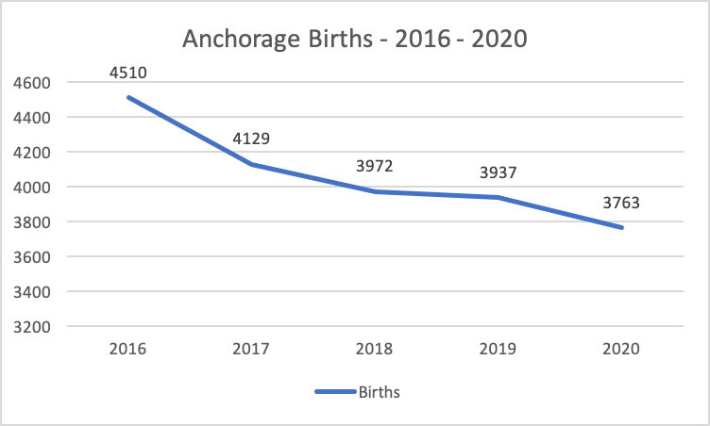
Anchorage Municipality Births
13

Slide 14
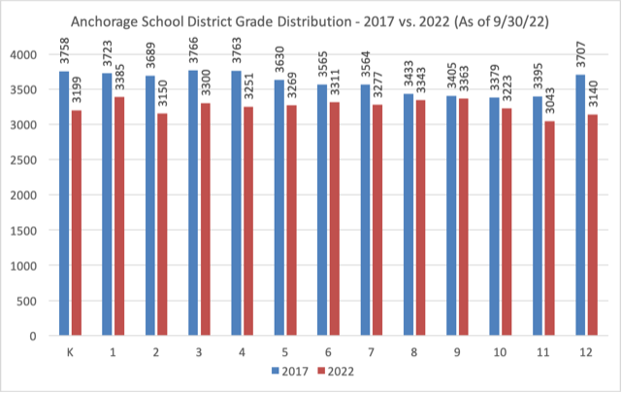
ASD Grade Distribution – 2017 vs. 2022
Smaller incoming grades.
14

Slide 15
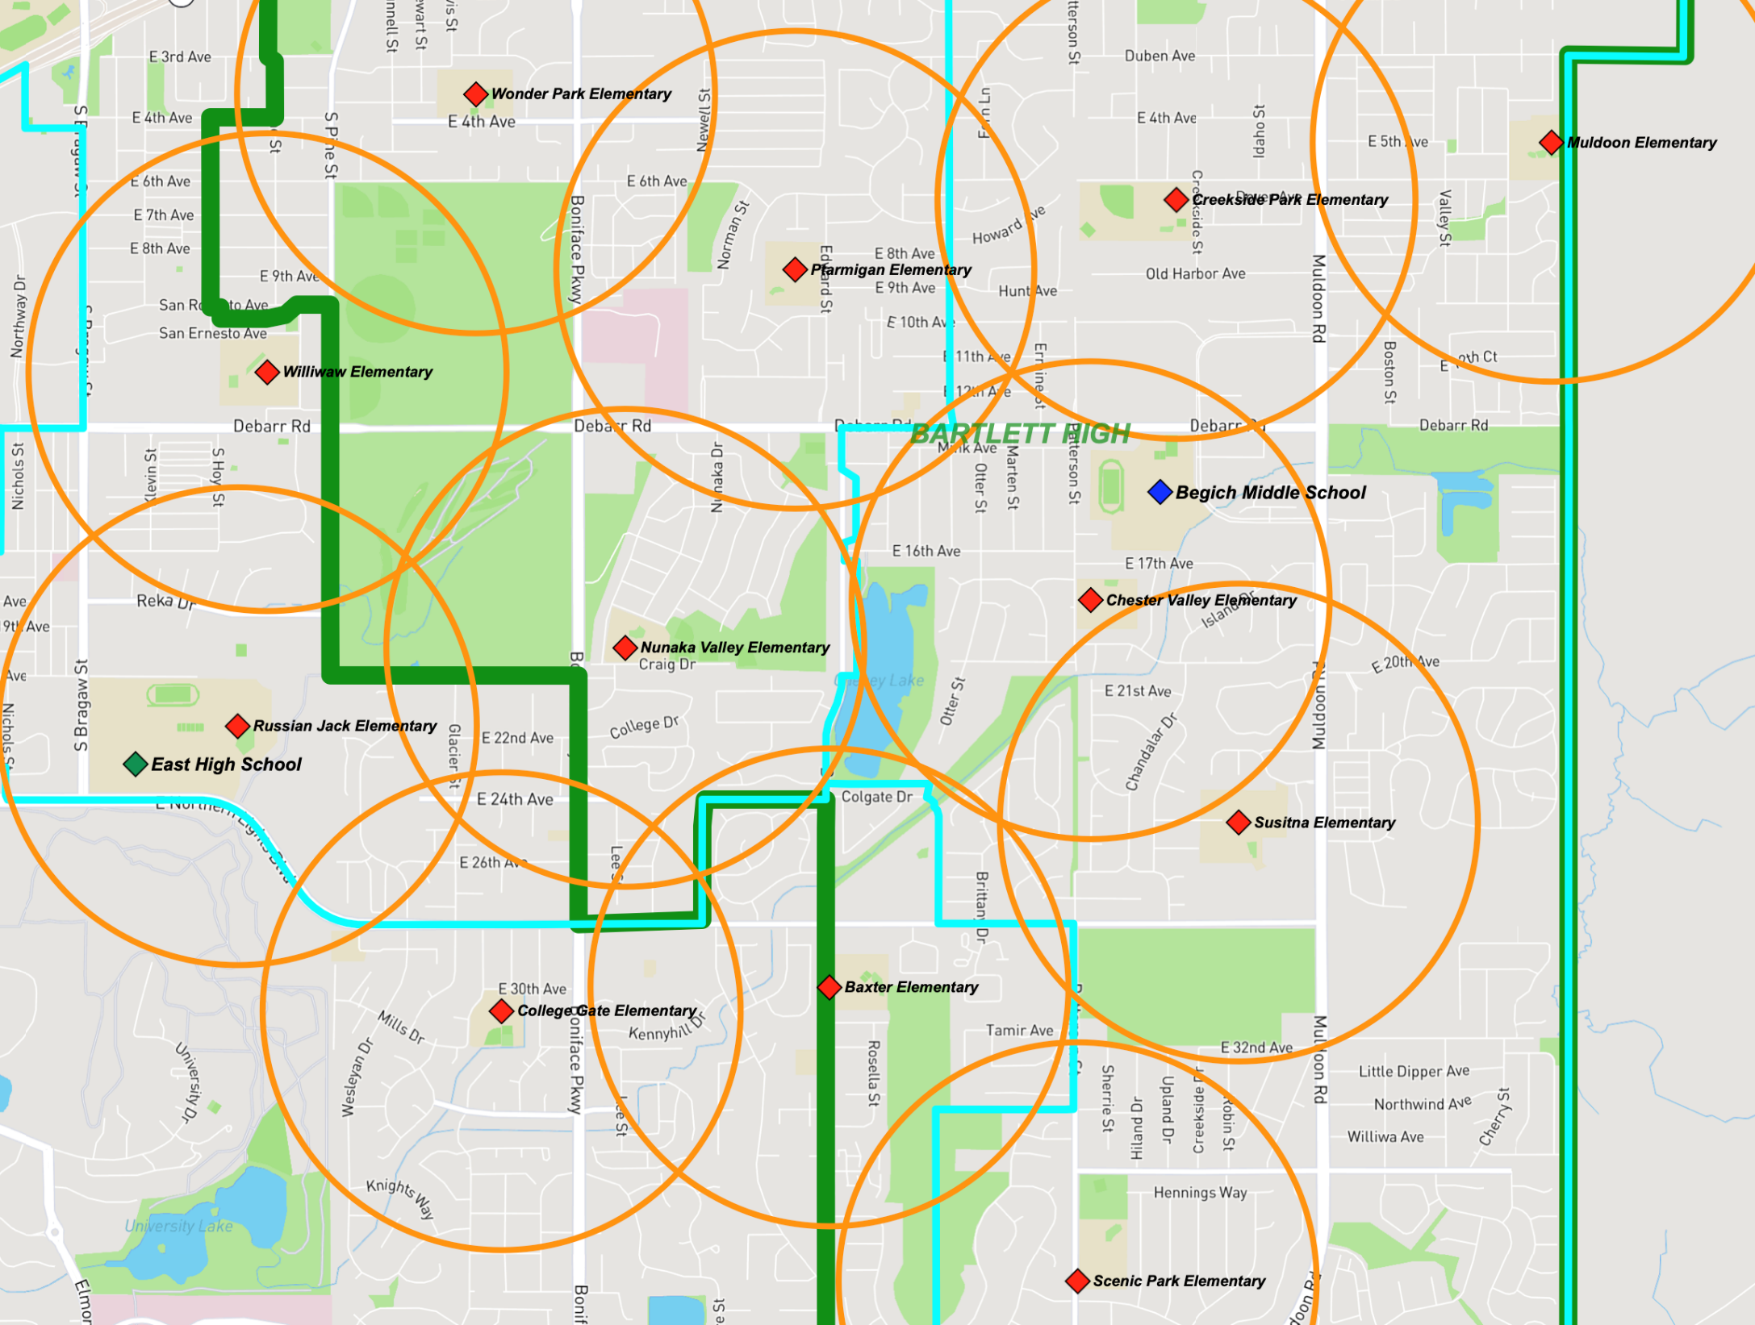
Tightly-clustered Schools Across the District
Northeast Anchorage has a dense concentration of low-utilization schools
15

Slide 16
School Closure Recommendations – Round 1
Closing Schools
Remarks
Receiving Schools
Kasuun – North of E. 88th Ave
Trailside – South of E. 88th Ave
Abbott Loop
(65%)
Utilize fire suppression funds to demo building
Programs affected: 1 Pre-K, 2 SpED Developmental Programs (3 & 4 years old)
Fire Lake
Homestead – Receives Gen Ed ABC students
Birchwood ABC
(51%)
Repurpose building
Programs affected: ABC, 2 Pre-K & 2 Life Skills programs
Campbell – North of Minnesota Dr. (Dimond Estates)
Ocean View – South of Minnesota Dr.
Klatt
(92%)
Repurpose building
Programs affected: Pre-K, 2 Structured Learning Classrooms
Chester Valley – East of Boniface
Russian Jack – West of Boniface
Nunaka Valley
(66%)
Repurpose building
Programs affected: Pre-K, 3 SpED Developmental Programs (3 & 4 years old)
Northwood
(69%)
Repurpose building
Programs affected: Pre-K, 5 SpED Developmental Programs (3 & 4 years old)
Lake Hood
Wonder Park
(55%)
Repurpose building
Transportation costs will increase
Programs affected: Pre-K
Williwaw
16

Slide 17
Town Halls
Briefing to school staff at 4pm; community at 6:30pm
Will provide more detailed information than this briefing
Surveys and feedback will be collected
District staff (GenED, SpED, Transportation, etc.) will be present
Dates for onsite Town Halls: Nov 2nd, 3rd, 14th, 16th, 21st and 22nd
Virtual dates TBD
Community
Town Halls
Allows staff & community to provide input and feedback to assist in:
  Refining facts and assumptions necessary for detailed planning
  Highlighting needs that must be addressed
  Informing and improving implementation planning
Purpose
17

Slide 18
FY24 Budget Deficit Monitor
School Board future discussions
FY 24 Deficit
(in $Millions)
Defer planned FY 23 ESSER spending
Sunset Committee analysis
Review alternative schedules (trimesters, lecture hall, start times, etc.)
1:1 computer plan options @ ES & MS levels
100
90
80
70
Preserve ≈ $16M one-time state funds for FY24
Meet or exceed FY23 projected enrollment
6th Grade Band/Orchestra, IGNITE & elementary immersion programs
60
ASD Virtual (ASDV)
Middle School Model
Hockey, swimming, soccer, gymnastics & Dome contract
50
Close six schools at the end of FY23
40
30
20
10
0
18
Created by ASD Finance, JEA, Oct 18th, 2022

Slide 19
Next Steps
Town Halls & Surveys
FY24
School Board
Decisions/Guidance
FY24
Proforma
Oct
Nov
Dec
Refine research and analysis on all available cost-reduction ideas
School Board Guidance
6th Grade to
Middle Schools
Middle School
Model
Metric-based
Staff
Immersion
Programs
Sports &
Activities
School Board Guidance
FY23 Bond
School
Close/Repurpose
Fund
Balance
One-time
Funds
Other/
TBD
IGNITE
Immersion
PTR
Admin
Created by ASD Finance, JEA, Oct 18th, 2022
19

Slide 20
School Board Comments/Guidance

